Slide 1
Grand Canal Greenway Phase 1
Project Update April 2026

Slide 2
Updates since May 2023
Completion of the towpath works from Aylmer Bridge to Sallins (11km) by contractor John Craddock Ltd.
Completion of the pedestrian Bridge linking over the Grand Canal on the East of Sallins Village.
This forms the completion of Phase 1 of the Grand Canal Greenway in Kildare.

Slide 3
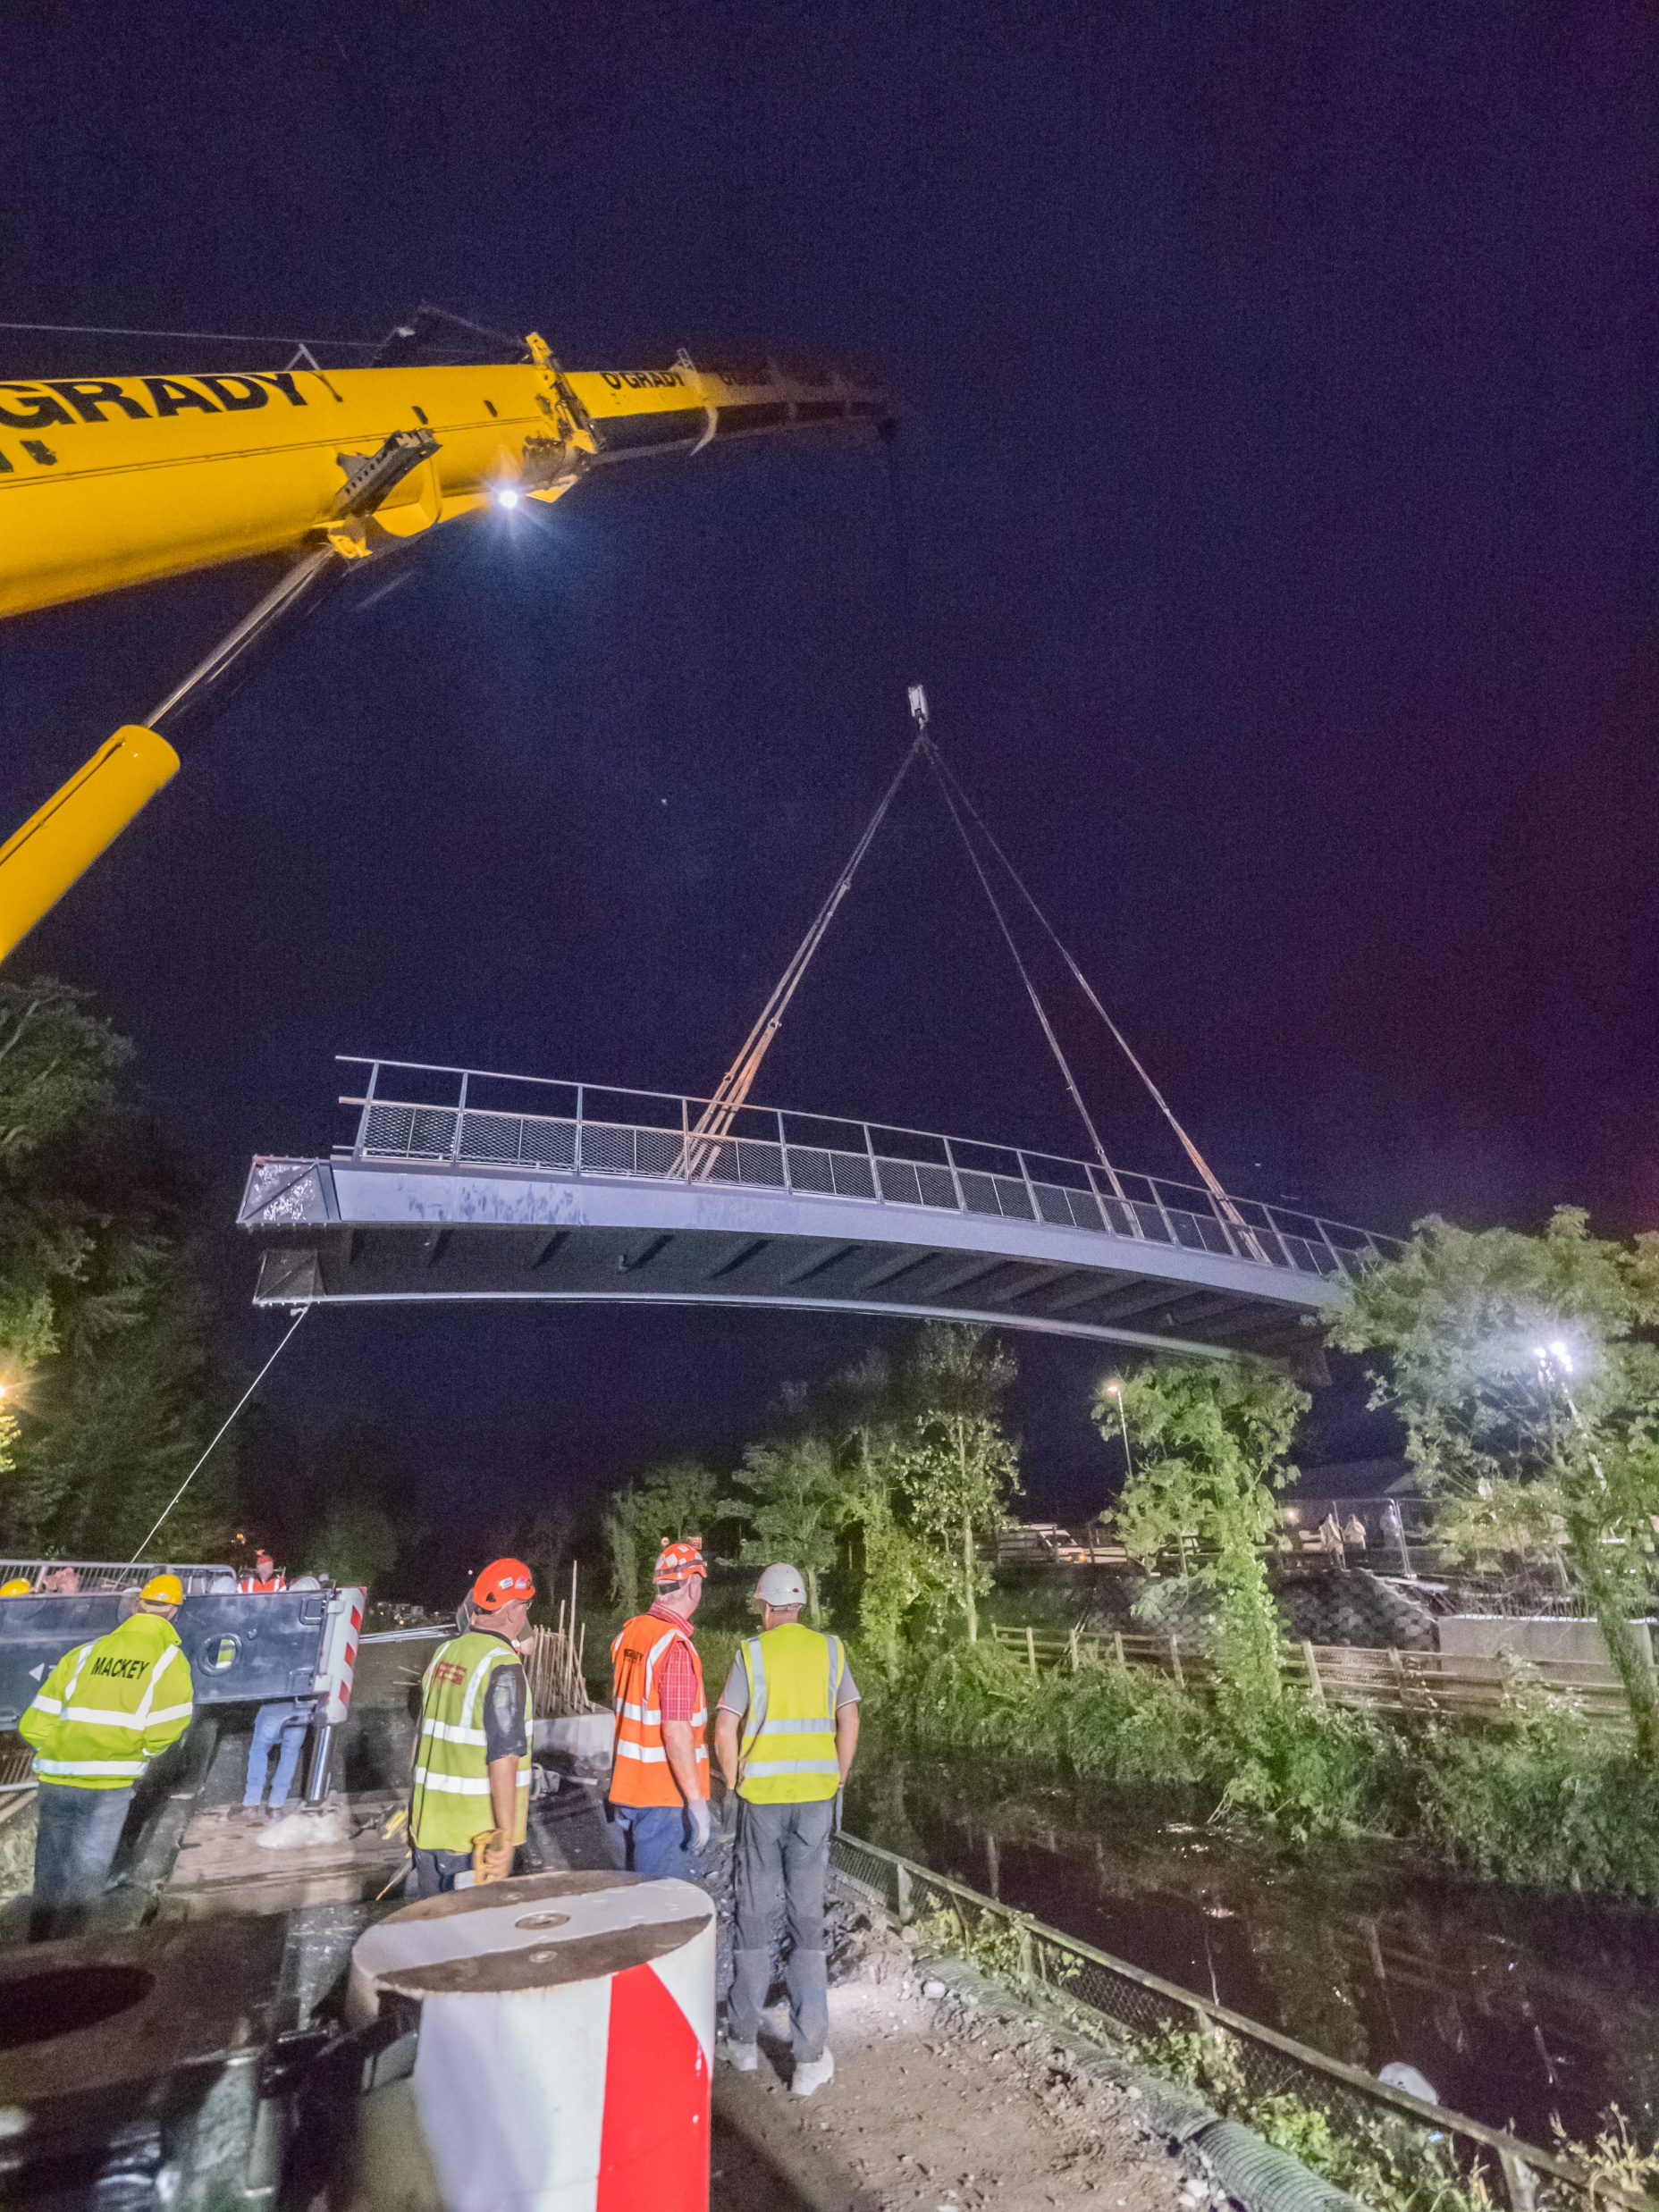
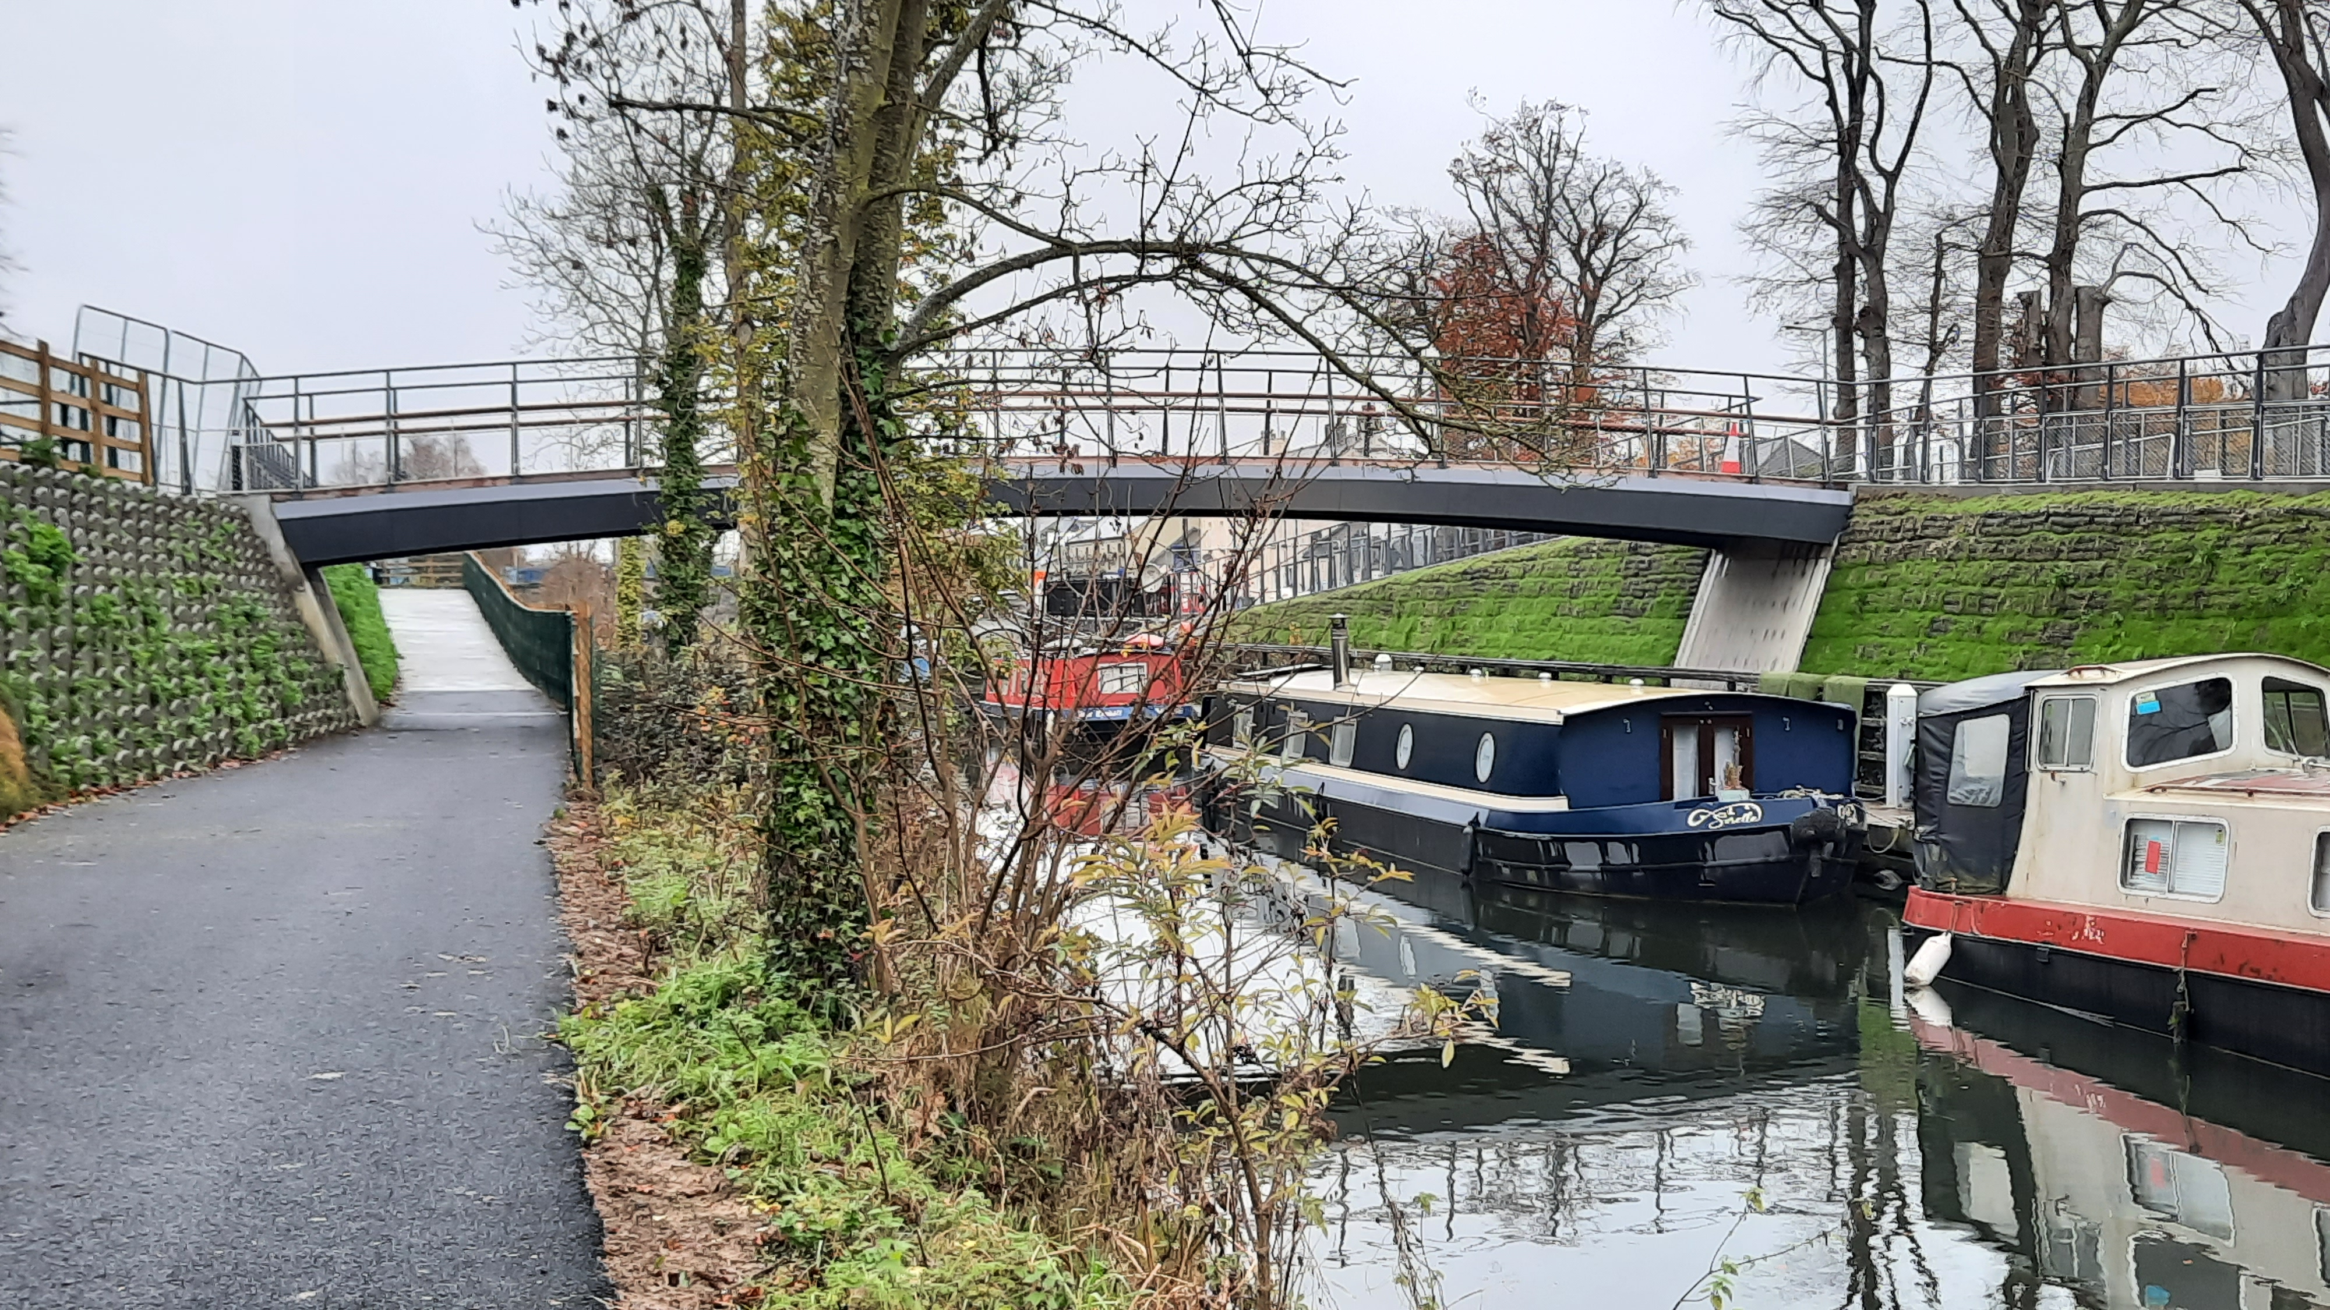
Sallins
Pedestrian Bridge installed in August 2023

